Slide 1
Money
Matters
Notes:
WELCOME SLIDE
So you’ve committed to a year of simple living…
You’ve probably been wondering how all the finances work.
Maybe you’ve wondered if you’ll have enough to eat?
Will the bills get paid?
What does it mean to live on $100?
What is a living allowance?
How will this work?
Hopefully a lot of your questions have been answered by this time in the week. And if not, maybe this presentation will help make things more clear.

Slide 2
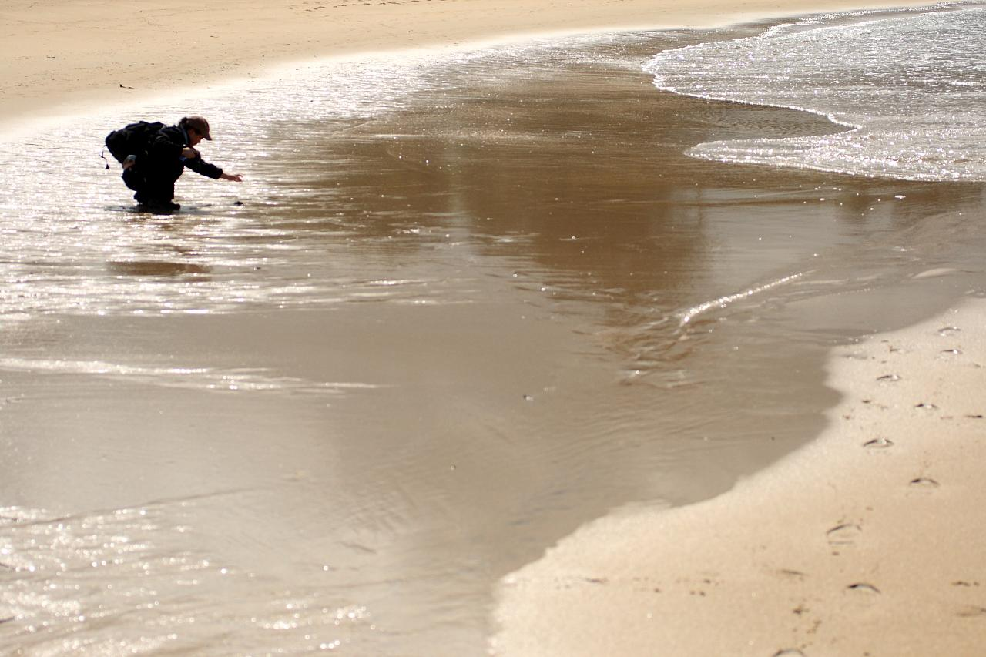
Notes:
PHILOSOPHY
Before we talk about how money and budgets work, we want to talk about our philosophy.
The year is not about feeling the pinch of living on $100/month, or acquiring as much stuff as you can for as little money as possible.
It’s about focusing on abundance - on what counts – relationships, spirituality, social and ecological justice, laughter, learning, experiences, memories. Focusing on slow experiences.
We talk about money because we exchange it for housing, shelter, clothing, etc. and because you’ll be pooling some of your money with your JV community this year. So we want to talk about how we help structure the flow of money through your JV community.

Slide 3
Agenda
Notes:
First we’ll preview our agenda:

Slide 4
Cash Flow Overviews
Notes:
AGENDA: Cash Flow Overviews

Slide 5
Notes:
AGENDA : Clarifying Terms

Slide 6
Notes:
AGENDA : Talk about Budgets

Slide 7
Financial Reports
Notes:
AGENDA : Financial Reports

Slide 8
Best Practices
Notes:
AGENDA : Best Practices

Slide 9
Values
Notes:
AGENDA : How Money relates to our Four Core Values

Slide 10
Notes:
AGENDA : Time for your questions today and tomorrow

Slide 11
Cash Flow Overviews
Notes:
SECTION: Cash Flow Overviews

Slide 12
Overview: AmeriCorps member
JVC Northwest
Monthly deposits for each JV
Community
Expenses
Community Account
JV Personal
Account
Individual Expenses
Savings
Notes:
CASH FLOW OVERVIEWS
This helps provide a visual of how the money flows.
You can find a more detailed image of this in your JV Handbook.
JVC Northwest pays the monthly living allowance directly to each AmeriCorps member.
Your living allowance is split between two direct deposits, one is to the community account.
You fill out the paperwork that dictates how much goes to the community account – this should be based on your community budget.
Out of this account, your community pays for community expenses.
The second direct deposit, your living allowance, covers individual expenses and savings.

Slide 13
Overview: Independent JV
JVC Northwest
Some Individual Expenses
Monthly deposits for each JV
Community Account
Community
Expenses
JV Personal
Account
Other
Individual Expenses
Notes:
CASH FLOW OVERVIEWS
For our JVs in independent placements it works like this
JVC Northwest pays JVs in independent placements monthly.
Your monthly deposit is split between two direct deposits.
One is to the community account. You fill out the paperwork that dictates how much goes to the community account – this should be based on your community budget. Out of this account, your community pays for community expenses.
The second direct deposit is to your personal account. Out of this account you cover personal expenses.
JVC Northwest will reimburse you for your co pays. ??? (do we want to talk more about this)

Slide 14
Community Cash Flow
JVC Northwest
Monthly deposits for each JV
Housing Fees and 3rd Retreat Fees
(AmeriCorps only)
Community Account
Individual JV bank
accounts
Other Community Expenses
Individual Expenses
Savings
(AmeriCorps only)
Notes:
CASH FLOW OVERVIEWS
Here is the cash flow from the community perspective.
JVC Northwest deposits money in community and individual accounts.
The community pays JVC Northwest for housing and third retreat fees.
The community spends money on utilities, groceries, and supplies.
Individual JVs pay for personal expenses, and AmeriCorps members save what’s left.

Slide 15
Notes:
SECTION: Clarifying Terms
Before we get into the details about money – we thought we’d go over some common terms we use that might be new or confusing.

Slide 16
Bookkeepers
Notes:
TERM: “Bookkeepers”
Each JV community has two bookkeepers who monitor your community’s spending, pay the bills on time, and report back to JVC Northwest about the monthly costs of your community.
This past year’s bookkeeper’s reports have helped us create your budgets for this new year.
Handbook: “Your house has two bookkeepers who are responsible for managing your community account and paying bills. The bookkeepers make electronic payments from the community account to JVC Northwest for the housing and third retreat fees for all AmeriCorps members in the community. JVC Northwest pays these costs directly for independent JVs.”
Guidebook: “Each JV community designates two of its members to serve as co-bookkeepers. They are responsible for keeping accurate financial records, for making timely deposits of community income, paying community bills on time, reporting financial issues to JVC Northwest, informing housemates about the community financial situation, and making monthly financial reports for the JVC Northwest Business Manager. However, the JV community is collectively responsible for making all decisions about expenditures. Any problems with finances should be reported to the Program Coordinator and/or the JVC Northwest office. “

Slide 17
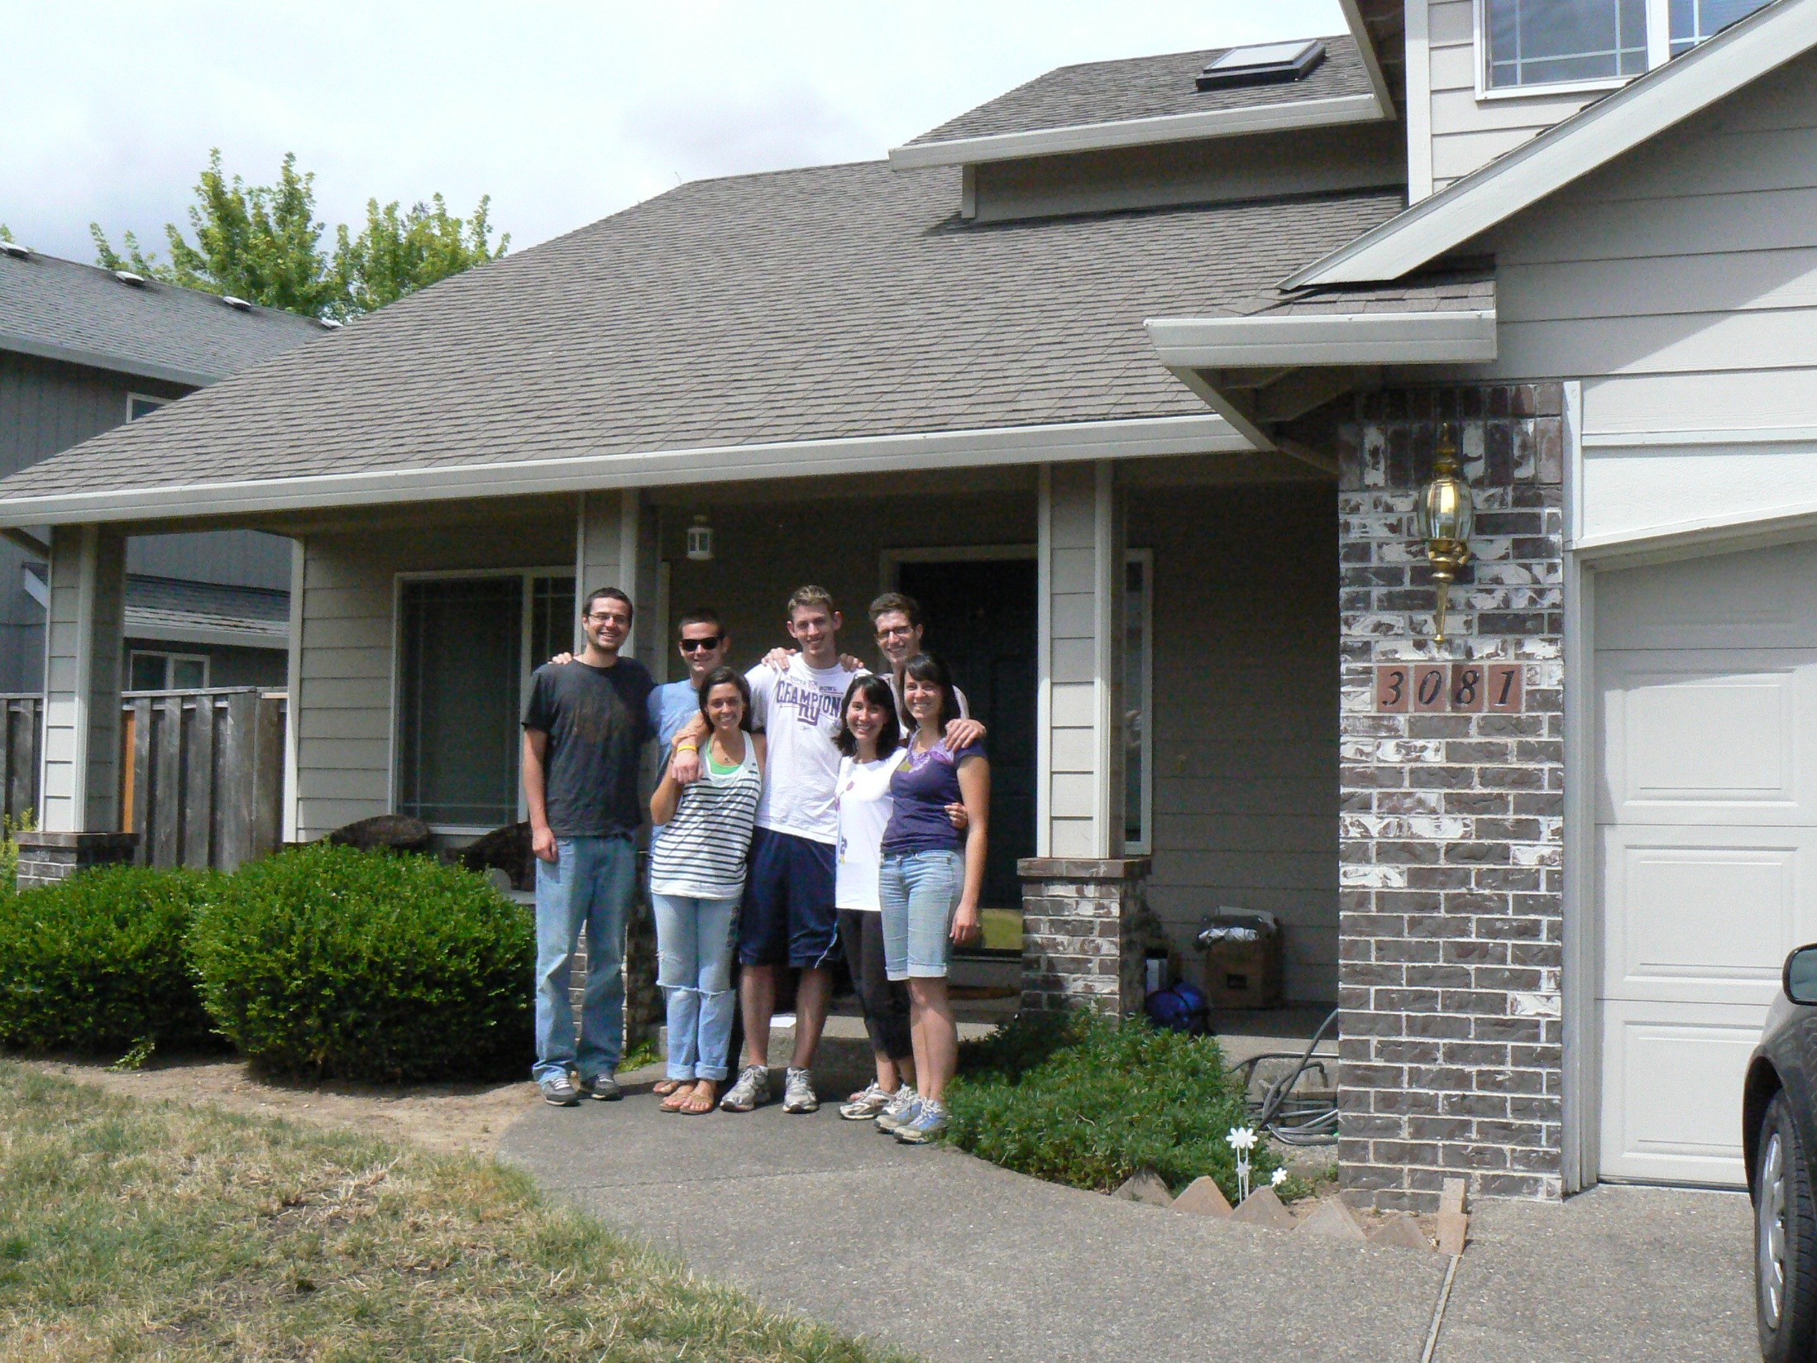
Community Bank
Account
Notes:
TERM: “JV Community Account”
When you arrive at your locales this weekend, you’ll go to a credit union or bank and open a checking account all together as a community.
You’ll also open up your own bank account.
You’ll use these accounts for your direct deposit from JVC Northwest, and your bookkeepers will use the ATM cards and checkbooks to pay bills.
Handbook: “Each JV community will also establish a community bank account in the names of all members of the community. This fund is for the JV community’s collective use; the money may not be spent for individual purposes. The community is responsible to maintain the community bank account and to pay all community bills from this account. A monthly financial report will be due to the office and is the responsibility of the bookkeepers (see below) to complete and send in to the JVC Northwest office. JVs may not use an ATM to withdraw cash from the community account. The community account must not be used to lend money to individual JVs in the community, to purchase alcohol, or to make community trips. Money leftover at the end of the year may be disbursed equally among members of the household, or invested in the house and supplies for the next year’s JVs.
We require JVs to establish individual and community accounts at the same bank or credit union, and to set up two direct deposits for your JVC Northwest income: one deposit to the community account and the other to your individual account.”
Guidebook: no definition provided

Slide 18
Contingency
Notes:
TERM: “Contingency Savings”
Money reserved for medical co-pays and deductibles, etc. AmeriCorps members save money every month to put towards their own contingencies. This money also may need to be used when there isn’t enough money to pay other bills (e.g. utilities are high one month). It is for contingencies.
Save this money so that it accrues month to month.
JVs in independent placements submit their receipts or invoices for medical co-pays to JVC Northwest. If you are a JV in an independent placement, please discuss your contingencies with your PC.
Additional-year JVs: What things have you needed to pay for out of contingency savings?
Note that you ALL have worker’s comp insurance through JVC Northwest. If you are injured at service, please let us know right away (same day if possible) and we can ensure you have the right paperwork to file a worker’s comp claim that will pay eligible medical bills.
Handbook: not defined.

Slide 19
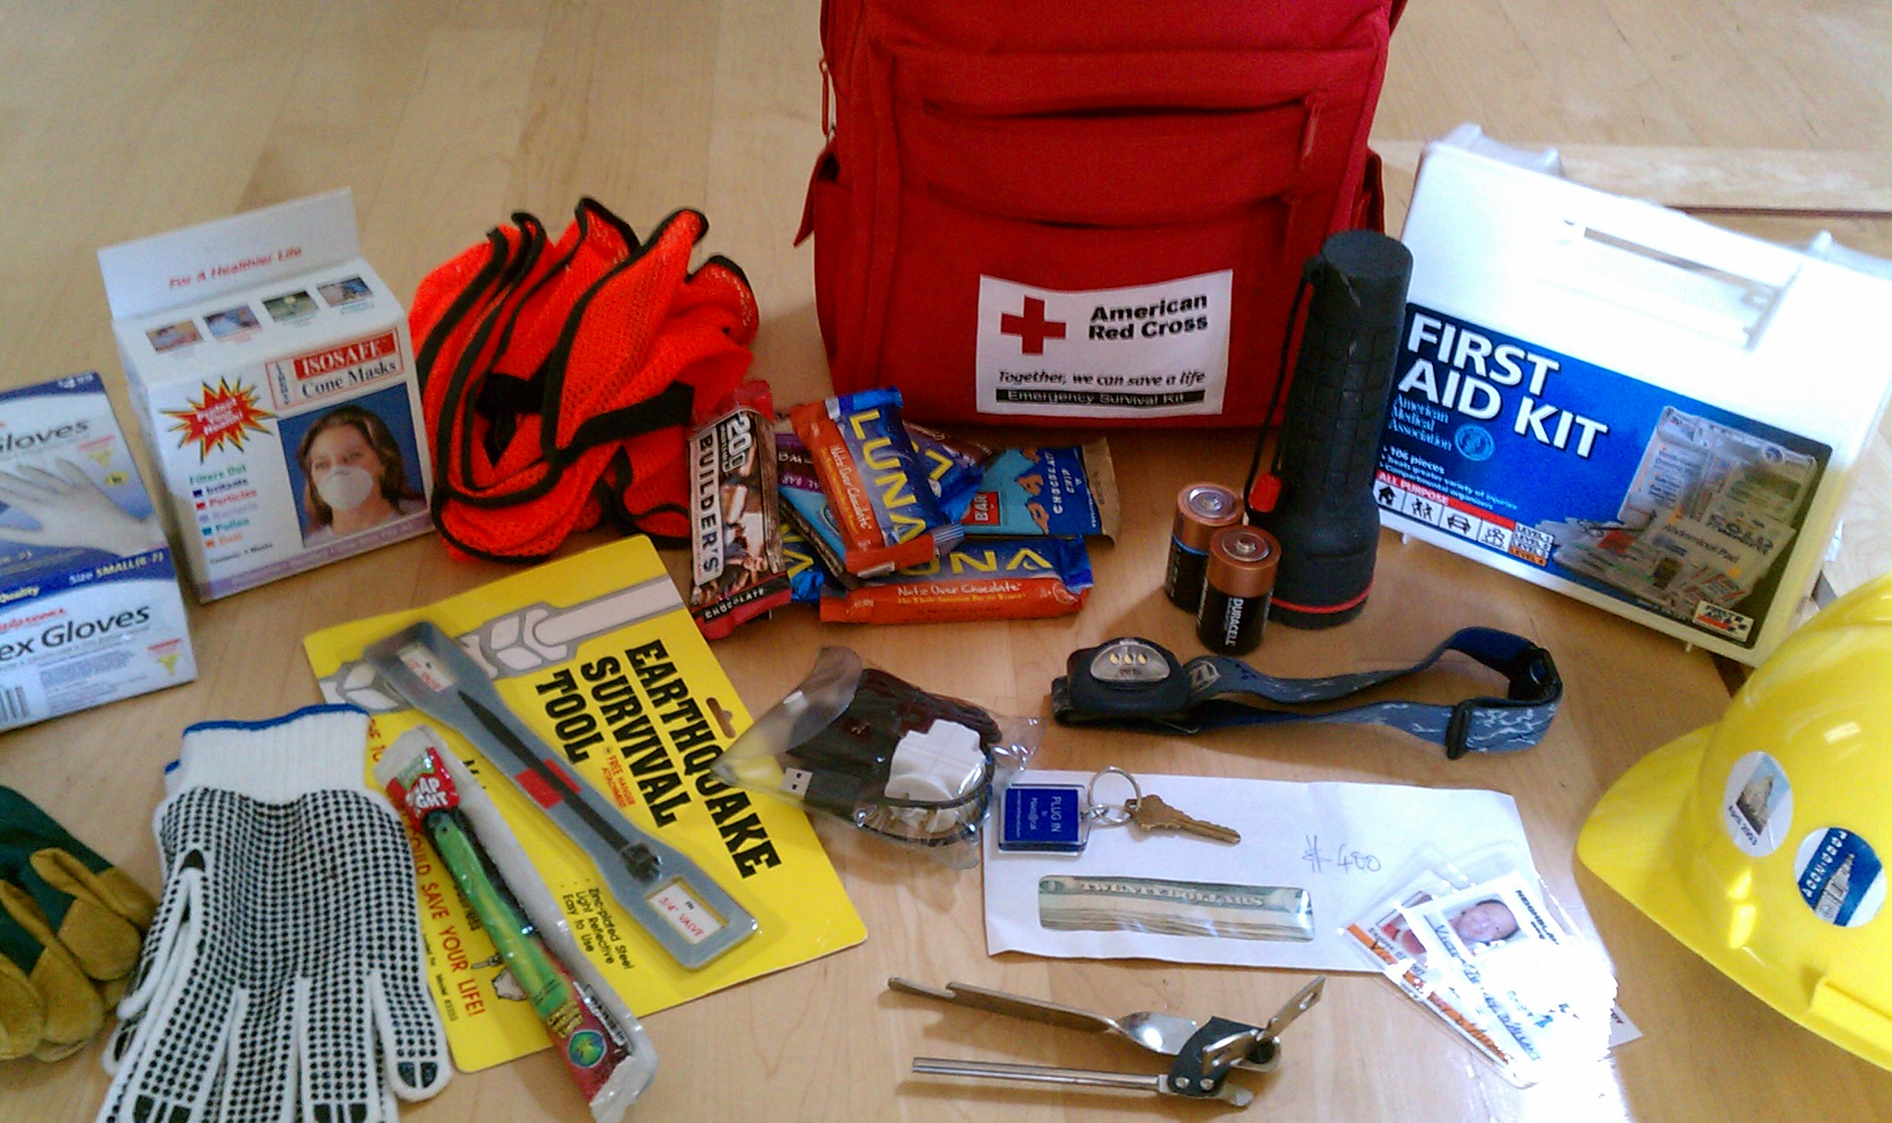
Emergency Supplies
Notes:
TERM: “Emergency Supplies”
Each month, each JV in the community will contribute at least $5 towards community emergency supplies.
In your community folder, you’ll find a booklet from the American Red Cross detailing ways to prepare for disasters such as earthquakes, floods, and wildfires. The booklet has a list of what you should include in your emergency kit.
When you arrive at your JV house, please take stock of your community’s emergency supplies – some of you may have a kit started, others of you will be starting from scratch.

Slide 20
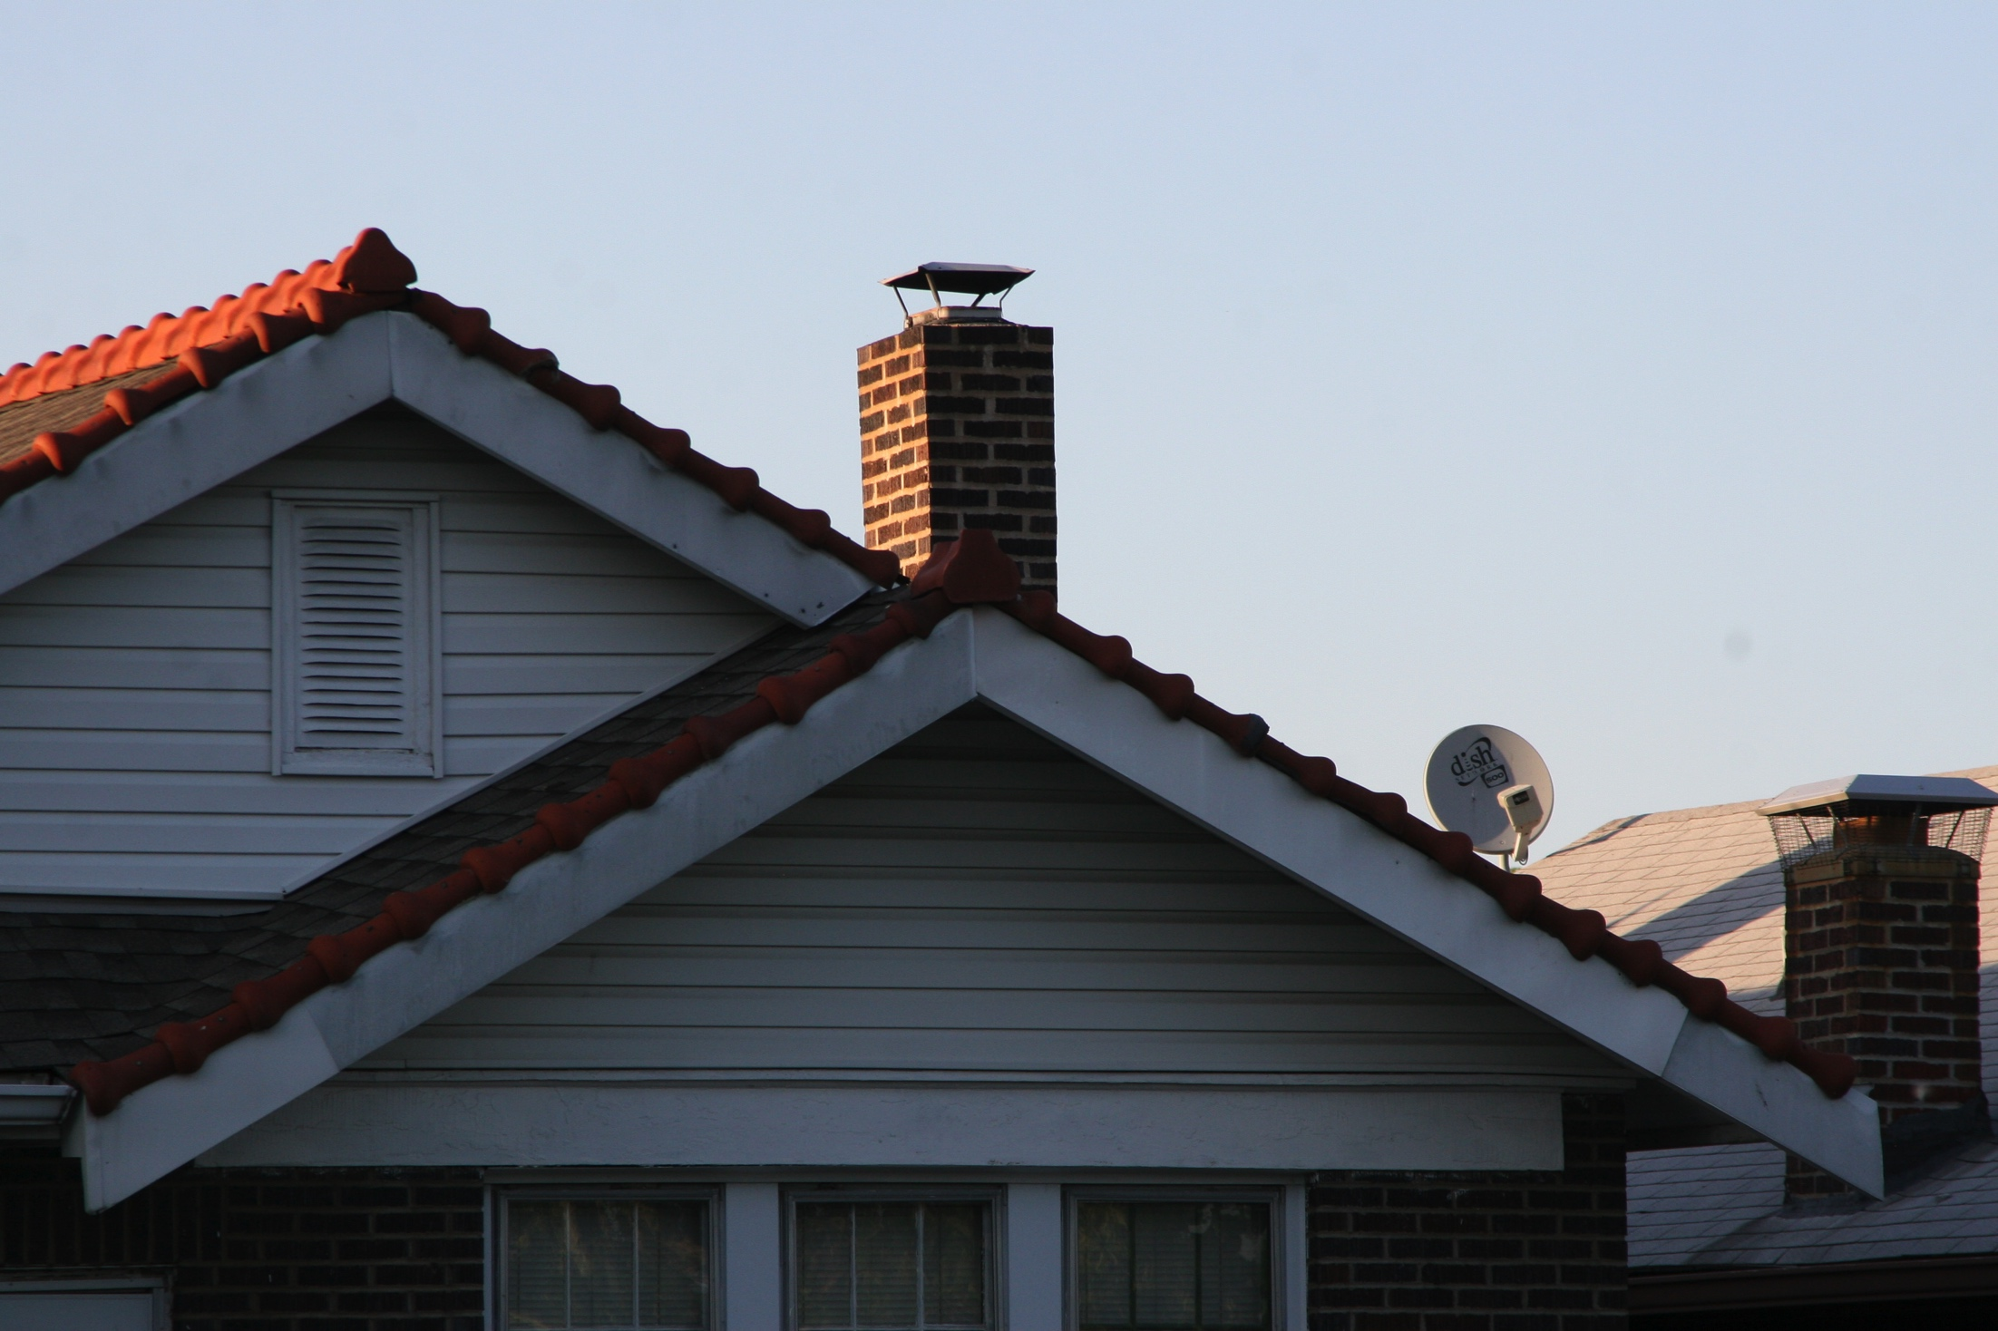
Housing fee
Notes:
TERM: “Housing fee”
All JVs pay the same housing fee - $6,100 for the year, prorated monthly according to the number of months you are serving.
12-month AmeriCorps members pay $425/month
11-month members pay $510/month
AmeriCorps members pay this from their living allowance. JVC Northwest pays this directly for JVs in independent placements.
The fee covers rent, repairs, deposits, cleaning and other related expenses for housing across the organization.
JVs serve in very diverse locales, from remote areas to cities. Actual rents vary as do the costs for other things.
We want to encourage JVs to serve where they feel called and for partner agencies to be matched with the JV who is the best fit for their needs. We do not want cost of housing to dictate placement decisions as a matter of equity.

Slide 21
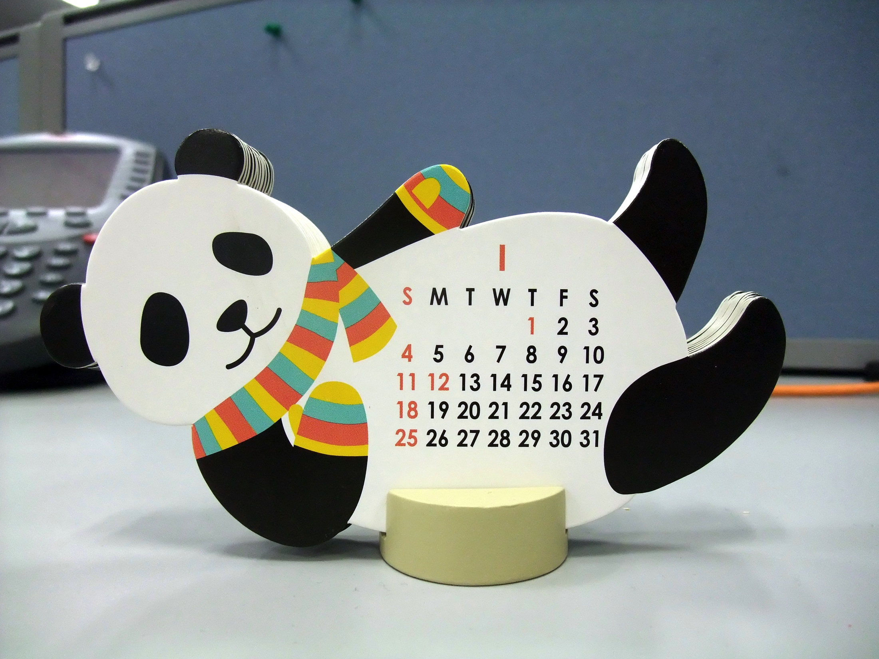
Monthly Income &
Living Allowance
Notes:
TERMS: “Monthly Income” and “Living Allowance” Monthly
JVC Northwest will direct deposit your income in your bank accounts you set up.
There are two types of monthly income:
AmeriCorps members:
Living Allowance - this is the specific term for the money JVC Northwest puts in your bank account every month when you are an AmeriCorps member.
AmeriCorps members receive $13,732 before taxes in equal installments over the year. This amount covers your basic costs plus $100/month personal income AND costs of medical co-pays.
JVs at Independent placements:
Independent JVs also receive a monthly deposit to pay your basic costs plus $100/month personal income. JVC Northwest will pay medical co-pays as needed.

Slide 22
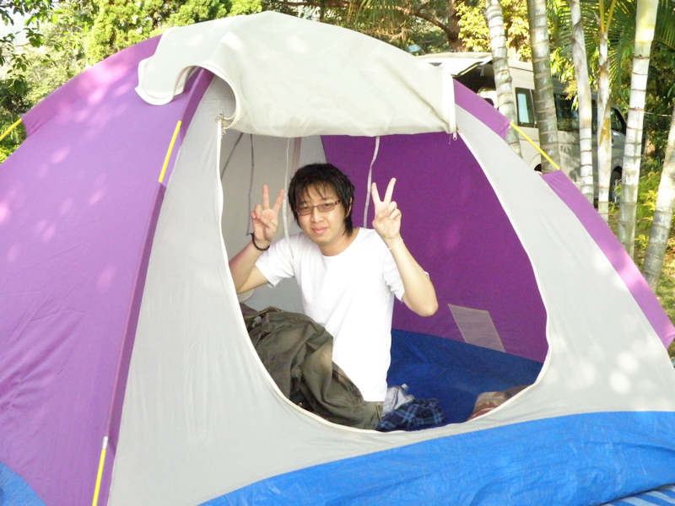
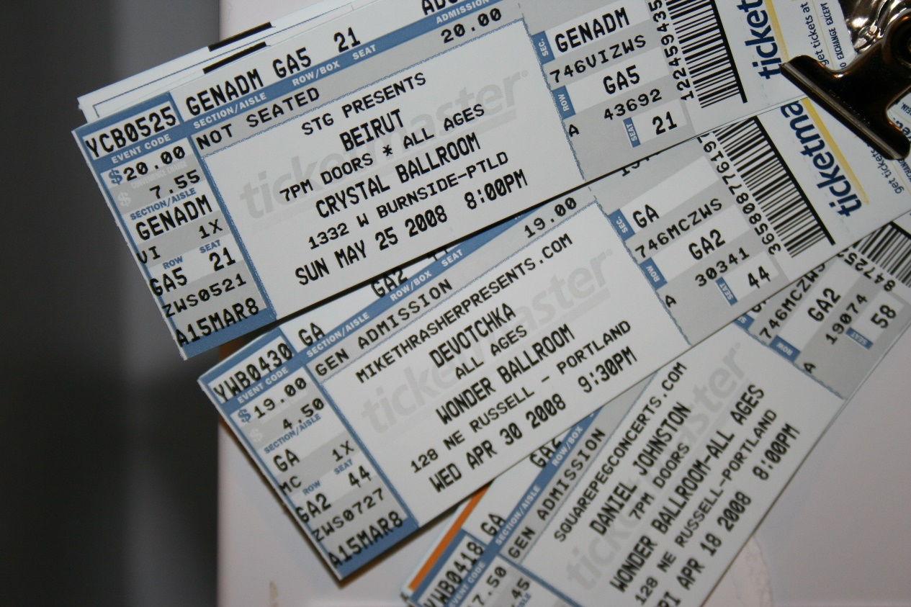
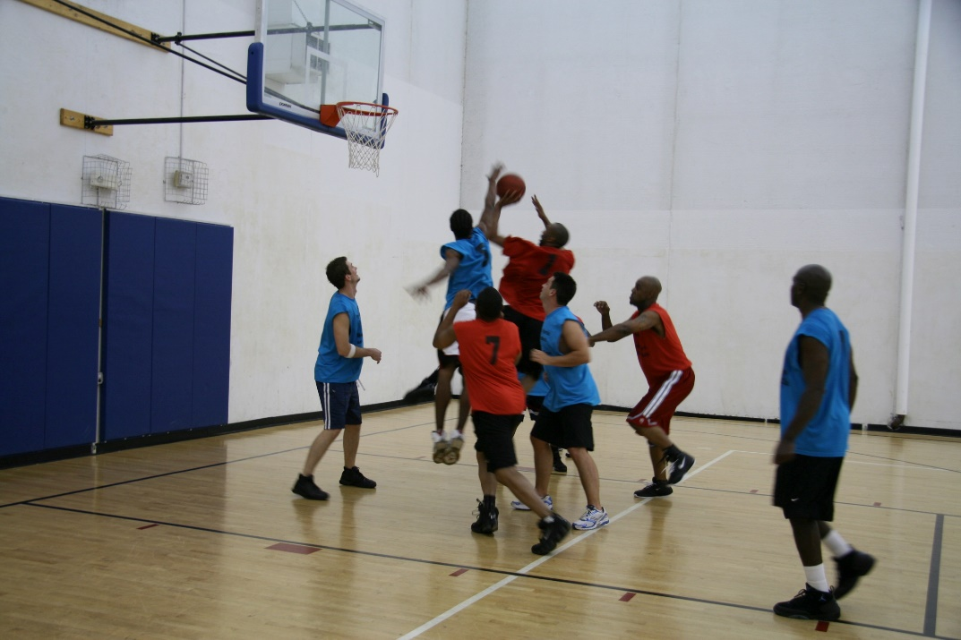
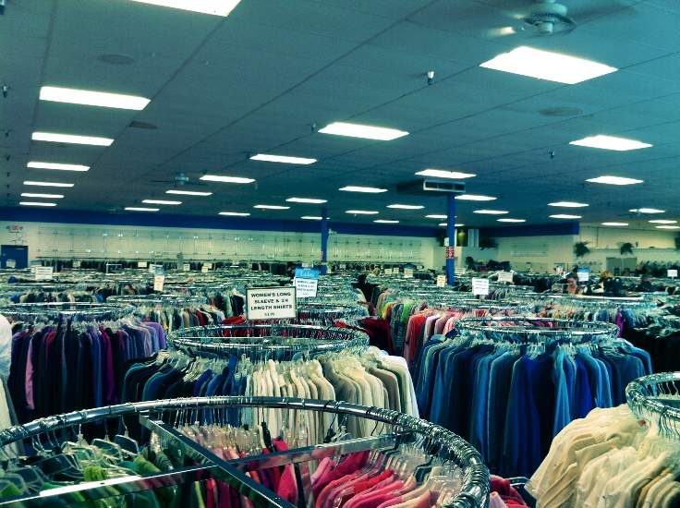
$100 Stipend
Notes:
Term: “$100 Stipend”
$100 budgeted for personal or discretionary spending, your money to live on for the month.
For items like: toothpaste, contact solution, shampoo, coffee shops, concerts, travel, phone bills, a new jacket, rain coat, camping trips, and potentially to supplement medical costs, new glasses, broken furniture in the house, etc.
It’s the money you live on and spend at your own discretion

Slide 23
Third Retreat Fees
Notes:
TERM: “Third Retreat Fee”
During the year you’ll go on three JVC Northwest retreats, each focusing on a different value.
The first two retreats focus on community and social & ecological justice. We pay for these retreats partially through our AmeriCorps grant.
The third retreat focuses on spirituality. Because of the separation of Church and state, we cannot apply AmeriCorps funds to this third retreat.
Therefore, we all chip in. JVC Northwest pays a portion, each of your placement agencies pay a portion, and we ask JVs to pay a portion.
Each month for 10 months, each JV pays $8 to JVC Northwest – that money goes to support the third retreat.

Slide 24
Utilities
Notes:
TERM: “Utilities”
What do you think is included as utilities?
Gas
Electricity
Oil (in places that are on oil heat)
Water
Sewer
House phone
Garbage
Yard work if required
You will pay the full amount all months that you are serving.

Slide 25
Notes:
SECTION: Budgeting

Slide 26
JV House Budget
Notes:
BUDGETING
What is a house budget?
House (community) budget – in your [color] Orientation folder
Discussed briefly at your Community Meeting with your PC
We created it for you to get started
It’s based on this past year’s JV expenses in your house
It’s a GUIDE – your community can discuss it and make adjustments at your weekly business meetings
Helpful to create your own personal budget as well

Slide 27
Deductions
Oregon Example
Annual Living Allowance | $13,732
Number of Months Serving in the Program | ÷ 12 mo
Monthly Gross | $1,144.33
Minus Federal and State Withholding and Income Taxes | -$249.31
Monthly Net | $895.02
Notes:
BUDGETING
[AmeriCorps Only]
Every AmeriCorps member earns $13,732 for the year, divided into equal monthly payments.
If you are a 12-month JV, your gross monthly pay is going to be $1,144.33.
Deductions that come out include state and federal taxes, social security, etc. and will vary according to the state you’re living in and the number of deductions you’ve claimed on your tax forms.
The total deposits you’ll receive from JVC Northwest in your bank accounts each month will reflect your gross monthly pay minus these deductions.
You can look at your monthly pay stub to see the details of what’s been withheld from your gross monthly pay.

Slide 28
JV AmeriCorps Member
JVC Northwest
Monthly deposits for each JV
$ for utilities, food, supplies
Community Account
Housing Fee
Third Retreat Fee
JV Personal
Account
Community Transportation
Notes:
BUDGETING
This helps provide a visual of how the money flows.
JVC Northwest pays the monthly living allowance directly to each AmeriCorps member.
Your living allowance is split between two direct deposits, one is to the community account. You fill out the paperwork that dictates how much goes to the community account – this should be based on your community budget. Out of this account, your community pays housing and Third Retreat fees, and food and utilities.
The second direct deposit of your living allowance covers your $100 stipend, your transportation costs (bus pass, bike maintenance, etc.), and the rest you save for contingencies – for example, any medical co-pays, etc.

Slide 29
JV AmeriCorps Member
JVC Northwest
Monthly deposits for each JV
Community Account
$100 stipend
JV Personal
Account
Local transportation
Contingency
Notes:
BUDGETING
This helps provide a visual of how the money flows.
JVC Northwest pays the monthly living allowance directly to each AmeriCorps member.
Your living allowance is split between two direct deposits, one is to the community account. You fill out the paperwork that dictates how much goes to the community account – this should be based on your community budget. Out of this account, your community pays housing and Third Retreat fees, and food and utilities.
The second direct deposit of your living allowance covers your $100 stipend, your transportation costs (bus pass, bike maintenance, etc.), and the rest you save for contingencies – for example, any medical co-pays, etc.

Slide 30
JV AmeriCorps Member
JVC Northwest
$ for utilities, food, supplies
Monthly deposits for each JV
Community Account
Housing Fee
Third Retreat Fee
$100 stipend
JV Personal
Account
Local transportation
Contingency
Notes:
This helps provide a visual of how the money flows.
JVC Northwest pays the monthly living allowance directly to each AmeriCorps member.
Your living allowance is split between two direct deposits, one is to the community account. You fill out the paperwork that dictates how much goes to the community account – this should be based on your community budget. Out of this account, your community pays housing and Third Retreat fees, and food and utilities.
The second direct deposit of your living allowance covers your $100 stipend, your transportation costs (bus pass, bike maintenance, etc.), and the rest you save for contingencies – for example, any medical co-pays, etc.

Slide 31
Independent JV
Housing Fee
JVC Northwest
Third Retreat Fee
Monthly deposits for each JV
Contingency
Community Account
JV Personal
Account
Notes:
BUDGETING
For our JVs in independent placements it works like this
JVC Northwest pays JVs in independent placements monthly.
Your monthly deposit is split between two direct deposits. One is to the community account. You fill out the paperwork that dictates how much goes to the community account – this should be based on your community budget. Out of this account, your community helps to pay food and utilities.
The second direct deposit is to your personal account. Out of this account you keep $100 monthly stipend and pay for local transportation, like a bus pass or bike maintenance. Make sure you request this of your PC if it is needed.
If you have medical expenses, JVC Northwest will reimburse you for your co pays.

Slide 32
Independent JV
JVC Northwest
Monthly deposits for each JV
$ for utilities, food, supplies
Community Account
Community Transportation
JV Personal
Account
Notes:
BUDGETING
For our JVs in independent placements it works like this
JVC Northwest pays JVs in independent placements monthly.
Your monthly deposit is split between two direct deposits. One is to the community account. You fill out the paperwork that dictates how much goes to the community account – this should be based on your community budget. Out of this account, your community helps to pay food and utilities.
The second direct deposit is to your personal account. Out of this account you keep $100 monthly stipend and pay for local transportation, like a bus pass or bike maintenance. Make sure you request this of your PC if it is needed.
If you have medical expenses, JVC Northwest will reimburse you for your co pays.

Slide 33
Independent JV
JVC Northwest
Monthly deposits for each JV
Community Account
JV Personal
Account
$100 stipend
Local transportation
Notes:
BUDGETING
For our JVs in independent placements it works like this
JVC Northwest pays JVs in independent placements monthly.
Your monthly deposit is split between two direct deposits. One is to the community account. You fill out the paperwork that dictates how much goes to the community account – this should be based on your community budget. Out of this account, your community helps to pay food and utilities.
The second direct deposit is to your personal account. Out of this account you keep $100 monthly stipend and pay for local transportation, like a bus pass or bike maintenance. Make sure you request this of your PC if it is needed.
If you have medical expenses, JVC Northwest will reimburse you for your co pays.

Slide 34
Independent JV
Housing Fee
JVC Northwest
Third Retreat Fee
Monthly deposits for each JV
Contingency
Community Account
$ for utilities, food, supplies
Community Transportation
JV Personal
Account
$100 stipend
Local transportation
Notes:
For our JVs in independent placements it works like this
JVC Northwest pays JVs in independent placements monthly.
Your monthly deposit is split between two direct deposits. One is to the community account. You fill out the paperwork that dictates how much goes to the community account – this should be based on your community budget. Out of this account, your community helps to pay food and utilities.
The second direct deposit is to your personal account. Out of this account you keep $100 monthly stipend and pay for local transportation, like a bus pass or bike maintenance. Make sure you request this of your PC if it is needed.
If you have medical expenses, JVC Northwest will reimburse you for your co pays and some other related items.

Slide 35
Community Cash Flow
JVC Northwest
Monthly deposits for each JV
Community Account
Individual JV bank
accounts
Notes:
BUDGETING
JVC Northwest deposits funds into your shared community account according to amounts you decide, based on your community budget. Any changes to a budget need to be discussed as a community and with your PC.
The bookkeepers then write a monthly check from the community bank account to JVC Northwest for the housing and 3rd retreat fees for all AmeriCorps members in the community. (JVC Northwest pays these costs directly for the JVs in independent placements)
All JVs contribute equally towards food, utilities, and community supplies.
The PCs shared with you earlier this week your community budgets. The amounts are based on what has worked for communities in the past. We recommend that you follow the budget and see how it goes. It may need to be adjusted. But for some things, you may not be aware of bills that come later in the year or will get higher later in the year. Utilities, for example, may be low now, but they will go up. You are paying into the account the same amount over the year to allow for these fluctuations. You are still responsible for these bills if you don’t have enough money in the community account. You may need to pay out of contingency. Its important to be flexible and review your expenses regularly. Follow the guidelines for best practices that have been shared with you.
JVC Northwest makes a second direct deposit into your personal accounts - $100 personal stipend and transportation costs. AmeriCorps members save any leftover funds to meet contingencies that may arise, such as a doctor’s visit that requires a co-pay.

Slide 36
Community Cash Flow
JVC Northwest
Community Account
Individual JV bank
accounts
$100 Stipend
Transportation
Contingency
(AmeriCorps only)
Notes:
BUDGETING
JVC Northwest deposits funds into your shared community account according to amounts you decide, based on your community budget. Any changes to a budget need to be discussed as a community and with your PC.
The bookkeepers then write a monthly check from the community bank account to JVC Northwest for the housing and 3rd retreat fees for all AmeriCorps members in the community. (JVC Northwest pays these costs directly for the JVs in independent placements)
All JVs contribute equally towards food, utilities, and community supplies.
The PCs shared with you earlier this week your community budgets. The amounts are based on what has worked for communities in the past. We recommend that you follow the budget and see how it goes. It may need to be adjusted. But for some things, you may not be aware of bills that come later in the year or will get higher later in the year. Utilities, for example, may be low now, but they will go up. You are paying into the account the same amount over the year to allow for these fluctuations. You are still responsible for these bills if you don’t have enough money in the community account. You may need to pay out of contingency. Its important to be flexible and review your expenses regularly. Follow the guidelines for best practices that have been shared with you.
JVC Northwest makes a second direct deposit into your personal accounts - $100 personal stipend and transportation costs. AmeriCorps members save any leftover funds to meet contingencies that may arise, such as a doctor’s visit that requires a co-pay.

Slide 37
Community Cash Flow
JVC Northwest
Community Account
Electric
Community Transportation
Landline Phone
Individual JV bank
accounts
Oil/Gas
Food
House & Yard Supplies
Emergency Kit
Year-end Cleaning
Notes:
BUDGETING
JVC Northwest deposits funds into your shared community account according to amounts you decide, based on your community budget. Any changes to a budget need to be discussed as a community and with your PC.
The bookkeepers then write a monthly check from the community bank account to JVC Northwest for the housing and 3rd retreat fees for all AmeriCorps members in the community. (JVC Northwest pays these costs directly for the JVs in independent placements)
All JVs contribute equally towards food, utilities, and community supplies.
The PCs shared with you earlier this week your community budgets. The amounts are based on what has worked for communities in the past. We recommend that you follow the budget and see how it goes. It may need to be adjusted. But for some things, you may not be aware of bills that come later in the year or will get higher later in the year. Utilities, for example, may be low now, but they will go up. You are paying into the account the same amount over the year to allow for these fluctuations. You are still responsible for these bills if you don’t have enough money in the community account. You may need to pay out of contingency. Its important to be flexible and review your expenses regularly. Follow the guidelines for best practices that have been shared with you.
JVC Northwest makes a second direct deposit into your personal accounts - $100 personal stipend and transportation costs. AmeriCorps members save any leftover funds to meet contingencies that may arise, such as a doctor’s visit that requires a co-pay.

Slide 38
Community Cash Flow
JVC Northwest
Housing Fees and 3rd Retreat Fees
(AmeriCorps only)
Community Account
Individual JV bank
accounts
Notes:
BUDGETING
JVC Northwest deposits funds into your shared community account according to amounts you decide, based on your community budget. Any changes to a budget need to be discussed as a community and with your PC.
The bookkeepers then write a monthly check from the community bank account to JVC Northwest for the housing and 3rd retreat fees for all AmeriCorps members in the community. (JVC Northwest pays these costs directly for the JVs in independent placements)
All JVs contribute equally towards food, utilities, and community supplies.
The PCs shared with you earlier this week your community budgets. The amounts are based on what has worked for communities in the past. We recommend that you follow the budget and see how it goes. It may need to be adjusted. But for some things, you may not be aware of bills that come later in the year or will get higher later in the year. Utilities, for example, may be low now, but they will go up. You are paying into the account the same amount over the year to allow for these fluctuations. You are still responsible for these bills if you don’t have enough money in the community account. You may need to pay out of contingency. Its important to be flexible and review your expenses regularly. Follow the guidelines for best practices that have been shared with you.
JVC Northwest makes a second direct deposit into your personal accounts - $100 personal stipend and transportation costs. AmeriCorps members save any leftover funds to meet contingencies that may arise, such as a doctor’s visit that requires a co-pay.

Slide 39
Community Cash Flow
JVC Northwest
Monthly deposits for each JV
Housing Fees and 3rd Retreat Fees
(AmeriCorps only)
Community Account
Electric
Landline Phone
Oil/Gas
Individual JV bank
accounts
Food
House & Yard Supplies
Emergency Kit
$100 Stipend
Transportation
Contingency
(AmeriCorps only)
Year-end Cleaning
Notes:
JVC Northwest deposits funds into your shared community account according to amounts you decide, based on your community budget. Any changes to a budget need to be discussed as a community and with your PC.
The bookkeepers then write a monthly check from the community bank account to JVC Northwest for the housing and 3rd retreat fees for all AmeriCorps members in the community. (JVC Northwest pays these costs directly for the JVs in independent placements)
All JVs contribute equally towards food, utilities, and community supplies.
The PCs shared with you earlier this week your community budgets. The amounts are based on what has worked for communities in the past. We recommend that you follow the budget and see how it goes. It may need to be adjusted. But for some things, you may not be aware of bills that come later in the year or will get higher later in the year. Utilities, for example, may be low now, but they will go up. You are paying into the account the same amount over the year to allow for these fluctuations. You are still responsible for these bills if you don’t have enough money in the community account. You may need to pay out of contingency. Its important to be flexible and review your expenses regularly. Follow the guidelines for best practices that have been shared with you.
JVC Northwest makes a second direct deposit into your personal accounts - $100 personal stipend and transportation costs. AmeriCorps members save any leftover funds to meet contingencies that may arise, such as a doctor’s visit that requires a co-pay.

Slide 40
Financial Reports
Notes:
SECTION: Financial Reports –
At the end of each month, the Bookkeepers will submit a financial report to JVC Northwest’s business office.
Bookkeepers will learn more about this during the Bookkeepers’ meeting tonight.
Each month we ask bookkeepers to send in a financial report This document breaks down your spending - by category. –
We recommend you talk about your budget periodically, so everyone knows how the money is spent. You may decide to cut back on certain things, or discuss plans to purchase something for the community or just to be reassured and know that the community cash flow is in a good place and things are getting covered.

Slide 41
Best Practices
Notes:
SECTION: Best Practices for Community Finances
Following some best practices for community finances will go a long way in avoiding misunderstandings or difficulties during the year.
It is the responsibility of all community members to be involved and mindful of the community account.
The co-bookkeepers will keep track of things, but this is YOUR money.
All JV should review transactions and know what is going on with the account. Read: TRANSPARENCY and set up a filing system that is available to everyone.

Slide 42
Budget with Mint
Notes:
BEST PRACTICES FOR COMMUNITY FINANCES
Use Mint or another app that allows every person in your community to monitor your community income and spending in real time.
Even if only 1 or 2 JVs have access to the community bank account, you can set up Mint so that everyone can see your bank account transactions and track your actual expenditures against your budget in real time.
Use Mint for free, online at your placement site, or on your phone, if you have a smart phone.

Slide 43
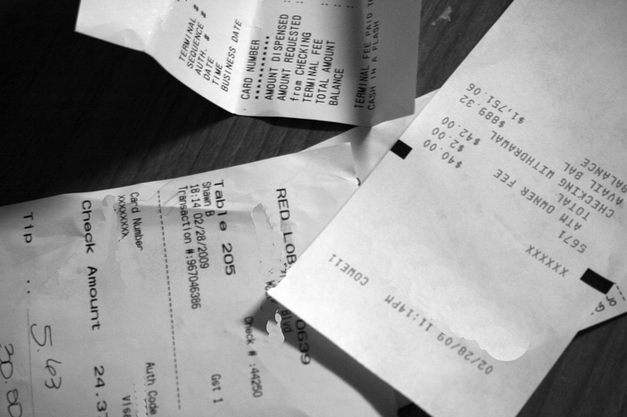
Save
Receipts
Notes:
BEST PRACTICES FOR COMMUNITY FINANCES
Practice keeping receipts for all community purchases and save the receipts in a place where all can access them during the year.
This information helps you understand what was spent and provides the detail when completing your financial report.

Slide 44
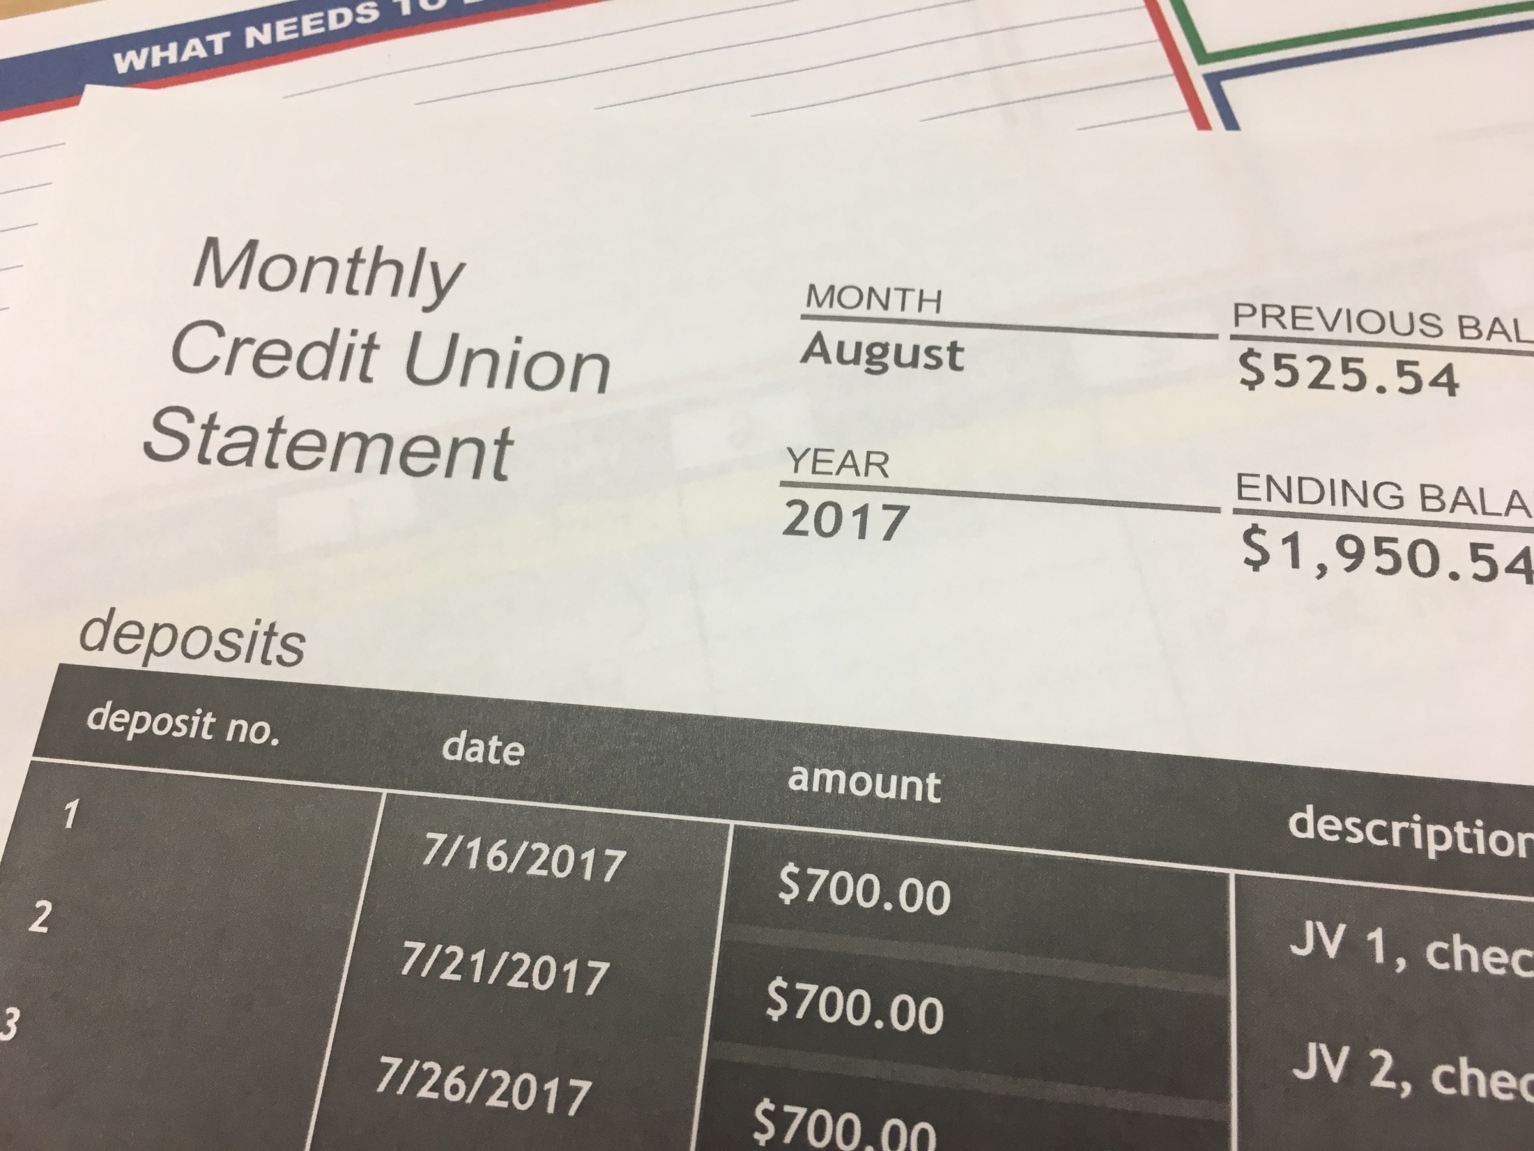
Request Paper Bank
Statements
Notes:
BEST PRACTICES FOR COMMUNITY FINANCES
In general, paperless is advisable.
However, for transparency and holding everyone in your community accountable, we urge you to request that paper statements are snail-mailed to your house.
Paper statements may be pinned to a centrally-located bulletin board and reviewed at least monthly.
Even if there is a fee for paper statements, in the long run, the fee is worth it, if it saves your community heart ache over missing funds.

Slide 45
Compare Receipts to
Monthly Bank
Statement
Notes:
BEST PRACTICES FOR COMMUNITY FINANCES
Monthly, all JVs in the community should review receipts and compare them to the monthly bank statement during business meetings.
Are any receipts missing?
Are any charges unexplained?
Save monthly bank statements and receipts – PCs will also review during area visits in the fall and winter
NOTE: If the two bookkeepers are not getting along, rotate bookkeepers. It’s crucial that the two bookkeepers maintain a healthy working relationship, and that both share responsibilities and accountability.

Slide 46
Limit Community Purchases
Notes:
BEST PRACTICES FOR COMMUNITY FINANCES
The community account is used only for food and housing (never for alcohol or for community outings), one may not give or take loans from the community account.
Use your individual account for personal needs – never use the community account
Always ask all JV community members for authorization prior to transferring community money to your personal account
[Ask the group questions: Can you buy alcohol with the community account? Can you take a loan from the community account?]

Slide 47
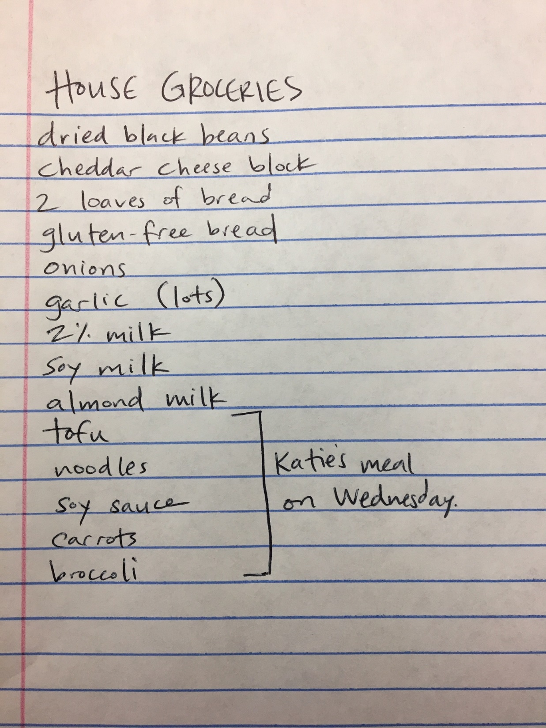
Use
Shopping
Lists
Notes:
BEST PRACTICES FOR COMMUNITY FINANCES
The community makes grocery lists together. Grocery shopping can be part of the chore chart and can rotate amongst the community.
Please clarify dietary restricts early on, and ensure that you budget for everyone’s needs to be met.

Slide 48
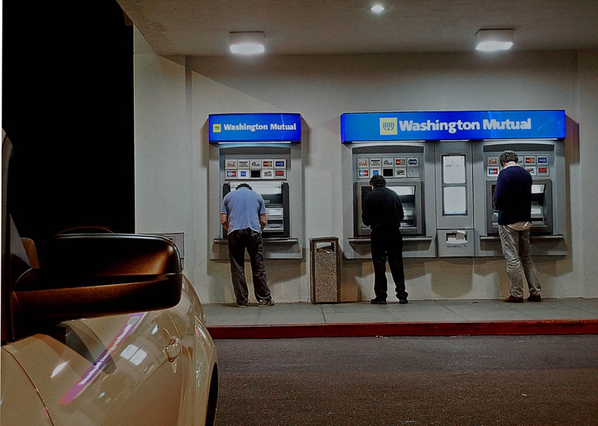
No ATMs
For the Community Bank Card
Notes:
BEST PRACTICES FOR COMMUNITY FINANCES
NO ATMs, no cash back, except for farmers market.
Community bank card should never be used at an ATM or to get “cash back”.
Exception:
Getting cash to spend on community needs at the farmer’s market. Save the ATM receipt as well as receipts and change from the merchants at the market.

Slide 49
Values
Notes:
SECTION: How Money relates to our Four Core Values

Slide 50
Social
Justice
Notes:
VALUES: Social & Ecological Justice
How you spend your money can be more powerful than how you vote, in terms of co-creating the community and economy you want to live in.
Conversations to have include:
Which purchases can you make from businesses owned locally and by people of color?
What can you find secondhand? What are you no longer using that you can pass along?
Will your community eat humbly and cheaply, shopping at the grocery stores frequented by your agency’s clients? Or
As people of privilege, will you humbly choose organic foods farmed and traded locally and fairly?
Will you decrease your community’s consumption of meat, petroleum, and other goods, in order to lighten your environmental footprint?
Will you be mindful of the impacts of food and packaging waste by buying in bulk, and reusing all that you can?
Who benefits and who is burdened by your purchasing decisions?
There are not right or wrong answers to these questions, but we expect that your community is engaging in these questions.

Slide 51
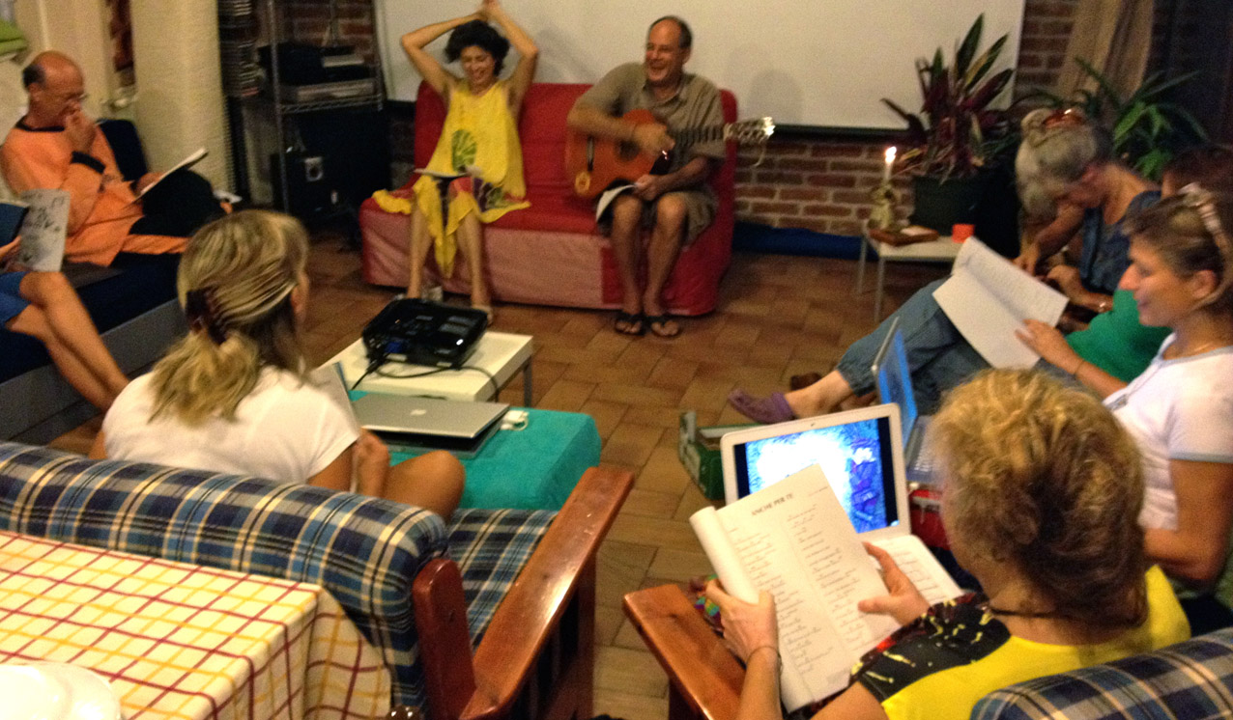
Community
Notes:
VALUES: Community
We expect that your community will make decisions together, by consensus. There are no declarative statements this year. Everything is a conversation.
When you know you are right, that should be a red flag – in response you should ask yourself, what perspectives are you missing?
Finally, when grocery shopping, all JVs’ dietary needs and preferences are accounted for.

Slide 52
Simple Living
Notes:
VALUES: Simple Living
How we approach spending reflects simple living by examining needs vs. wants.
AYs- can you offer examples of needs v. wants during your JV year?
This will be a year of thinking carefully about what you need versus what you want.
It’s actually exciting to be challenged in this way and can be quite freeing.
Support each other and you consider some things that you might have been used to that you may have considered a need…for example a latte every day, versus what is really a want. (this is awkward)
We invite you to consider downgrading from a smart phone to a simple cell phone. Do you really need to go out to a concert or buy a book. What are the local resources available to me. How can sharing and doing without open us up to new ways of being. This is where community members can really help you.

Slide 53
Spirituality/
Reflection
Notes:
Values: Spirituality/Reflection
By asking us to be intentional and examining how our spending impacts relationships with ourselves, each other and the earth.
Spirituality and reflection ties the others together as we reflect on our spending and the way we use our money.
How does it impact the earth, our relationships with each other and with ourselves?
How does it impact the way I spend my time?
What new freedoms does it invite?
We invite to reflect on this throughout the year, individually and as a community.

Slide 54
Notes:
QUESTIONS
Finally: Bookkeepers, you can ask questions during tonight’s bookkeeper meeting.
Additionally, throughout the year, you are welcome to look in your JV Handbook’s Money Matters section and speak with your Program Coordinator.
For now, we would like to hear your burning questions – if you have questions, others in the room might be wondering the same questions too.

