Slide 1
#Relationship Goals
A Kinesthetic Exercise
Meet in the Gym First

Slide 2
RE-Center Consent in relationship
Behaviors, Boundaries, and Blessings

Slide 3
There is a class

Slide 5
Socially Constructed Power

Slide 6
How do you know if there’s consent?
Did they ask with words?
NO
There’s not clear
consent
NO
Way to work. There is
clear consent. (This time.)
NO
Great. Did they respond with words?
YES!
YES!
Are you both willing to discuss any potential power dynamics, backgrounds, experiences, or concerns?
YES!
Great! Did you both discuss any other power dynamics,
backgrounds, experiences, or concerns?
Not exactly…
YES!
Not exactly…
Great! Were their
words positive?
Is this a person with whom you serve or
Who is a staff member at your service site?
YES!
NO

Slide 7
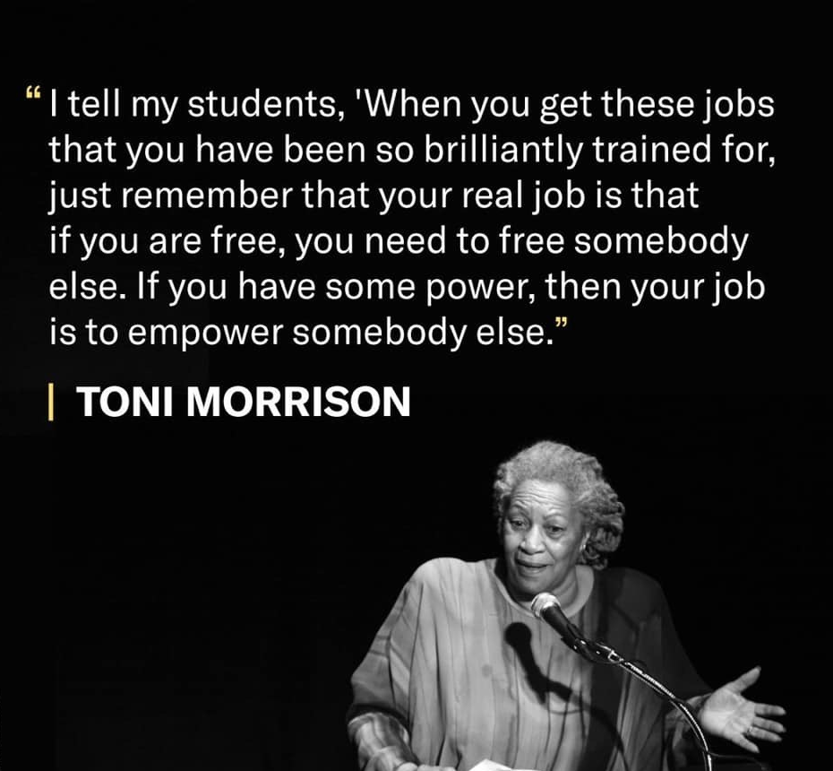
Personal Power

Slide 8
Focus on what they do rather than what they say
(also check in with how you feel)
Helpful
mental
emotional
physical
spiritual
Unhelpful

Slide 9
Belief Drives Behavior
Belief
Rule
Behavior
If….then…..

Slide 10
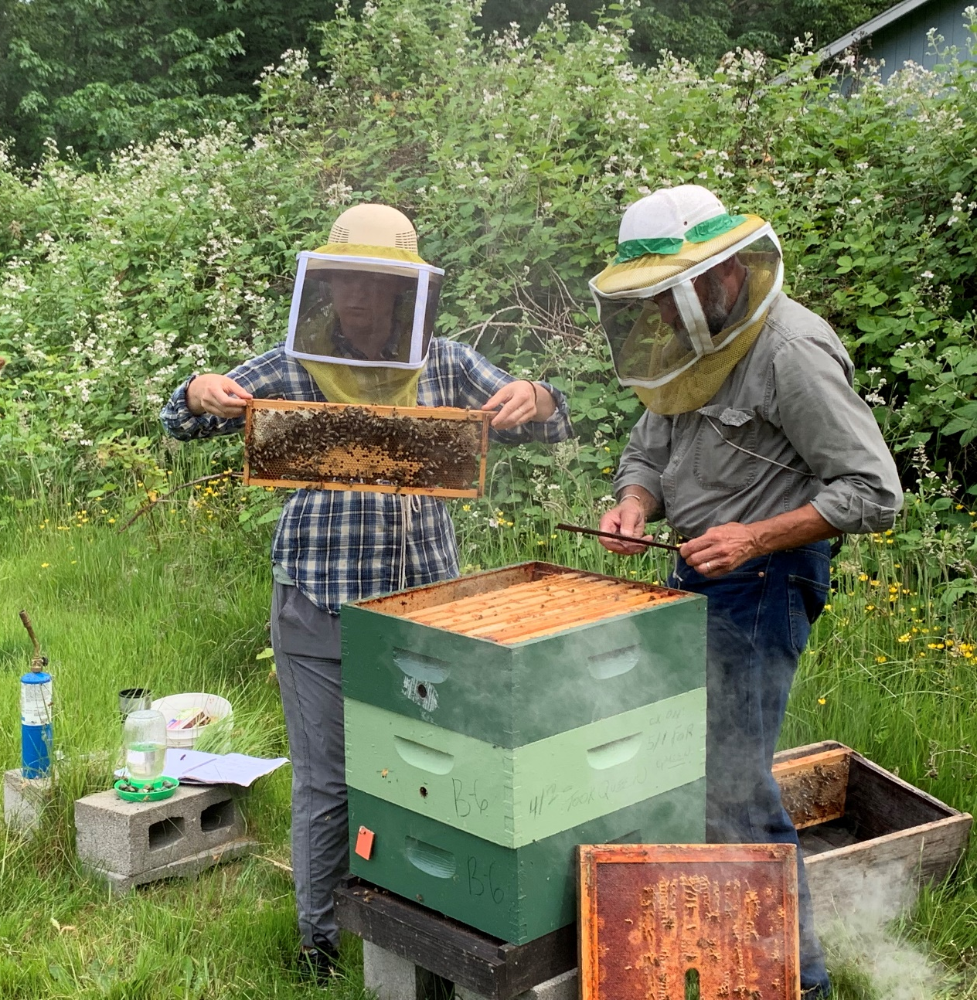
Go Forth and Be of Service!
Be the change you want
to see in the world!

